Slide 1

Base Reuse Plan
“Post-Reassessment”
FORA Board Policy Workshop #1
Fort Ord Reuse Authority
February 15, 2013

Slide 2
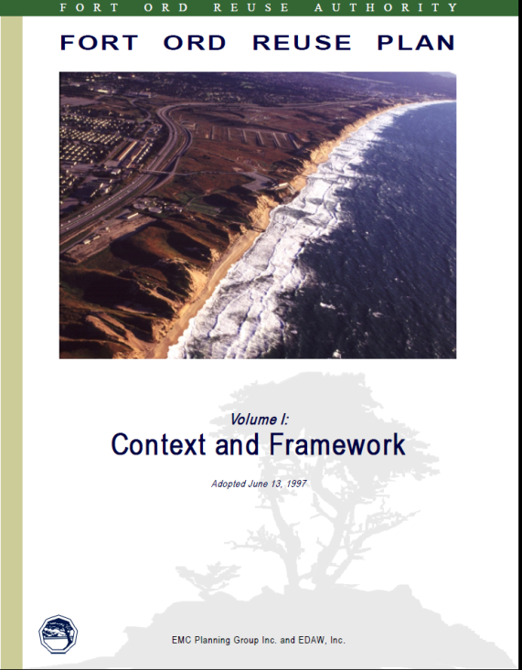
1997 Base Reuse Plan
Land Use Goal:
Balanced development, ensuring
Economic and
Educational opportunities with
Environmental protection (page 17)
“The vision for the future of the former Fort Ord is that a community will grow up on the former Base, having a special character and identity… Most importantly, the community will be a special place for living and working. It will provide a diversity of experience and opportunity, with a development approach that is sustainable and appropriate.” (pages 8-9)
Most recent republication: 2001

Slide 3
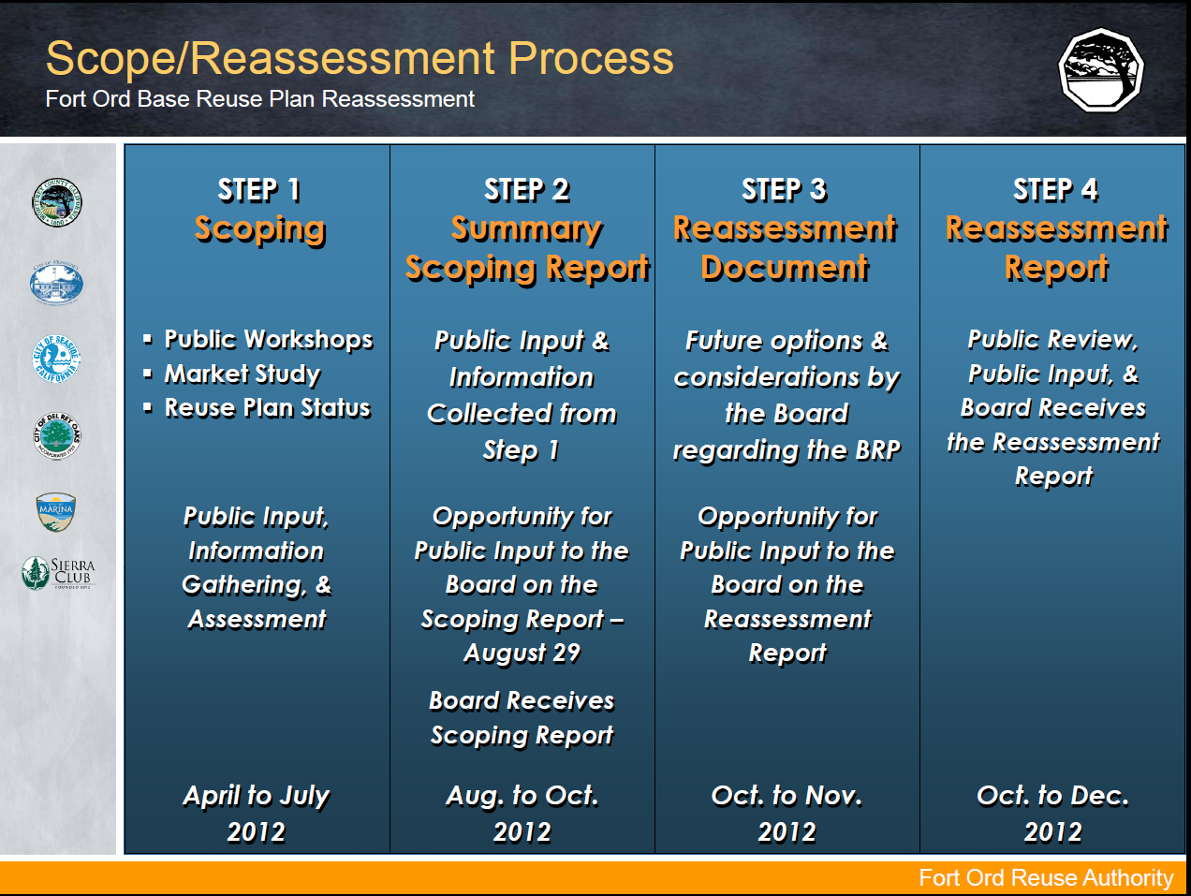
2012 BRP Reassessment Process

Slide 4
2012 Reassessment Outcomes - broad overview
BRP vision implementation – Significant successes to date:
Permanent open space preservation, 2/3 of the former base
  Habitat protection, open space conservation, and rec. opportunities.
  Fort Ord Nat’l Monument, Fort Ord Dunes State Park.
Educational and research institution creation/enhancement
  CSUMB, UC, MPC, MCL, Chartwell, MIRA, and others.
Incomplete Base-reuse programs:
Completion of BRP policies and programs
  Jurisdictional and FORA obligations (e.g., regional design guidelines)
Fulfillment of economic opportunities
  Job-creation/training for communities impacted by base closure.
  Building a balanced, vibrant, and dynamic local recovery.

Slide 5
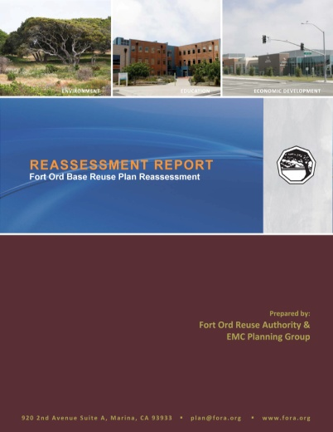
Reassessment Report (Dec. 2012)
  Policy topics/options:
  Category I BRP Modifications & Corrections
  (i.e., typos, outdated references, minor clarifications)
  Cat. II Prior Board Actions & Regional Plan Consistency
  Cat. III Implementation of BRP Policies & Programs
  Cat. IV BRP Policy & Program Modifications
  Cat. V FORA Procedures & Operations
Workshop 1
(Feb. 15)
Workshop 2
(Mar. 22)
Workshop 3
(Apr. 19)
  (see Feb. Board report attachments for more details about each of the Categories, I-V)

Slide 6
Post-Reassessment Workshops (Feb.–Apr. 2013)
Overall goal: Develop a priority list, work plan, and schedule for post- reassessment policy action items (Cat. I-V topics/options from the Reassessment Report).
Today’s goals:
  Background and overview discussion for planned workshops;
  Discussion of policy implementation factors (cost, timing, prioritization, etc.) affecting overall post-reassessment work plan development; and
  Board endorsement of a follow-up timeline for Cat. I/II action items --see Board Report Attachment A for staff recommendations.
Workshop facilitator:
Scott McCreary, PhD
CONCUR, Inc.

